Slide 1
A Bayesian Network Approach for Cardiovascular Risk Prediction
Large-Scale Statistical Methods
Mitsis Koutoukis Alexandros
Nteits Nikolaos
Tsitsimpasis Stefanos
2024-2025

Slide 2
Bayesian Networks in Cardiovascular Research
Study
Focus on developing a Bayesian network for analyzing cardiovascular disease (CVD) risk factors.
It is a multifactorial problem involving:
Lifestyle factors (e.g., smoking, exercise, diet).
Non-modifiable factors (e.g., age, genetics).
Bayesian networks are widely used in medical research to study complex health problems
Previous work
Focus on developing a Bayesian network for analyzing cardiovascular disease (CVD) risk factors.
Cardiovascular epidemiology (Framingham Heart Study)
Real-time prediction of cardiovascular events
Relationship between CVD and lifestyle factors (exercise, diet etc)
The work of Ordovás et al. expands on these factors, integrating multiple risk variables.

Slide 3
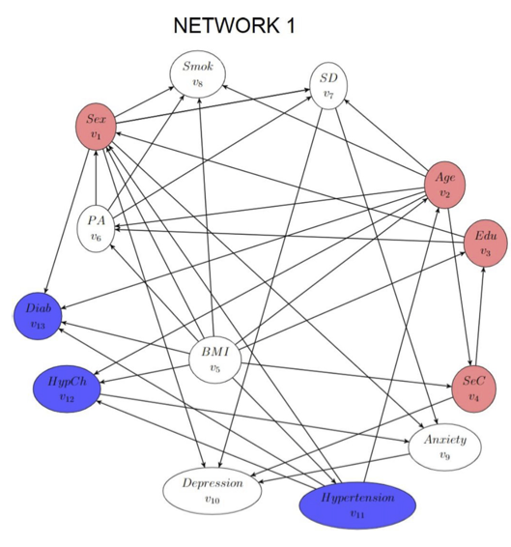
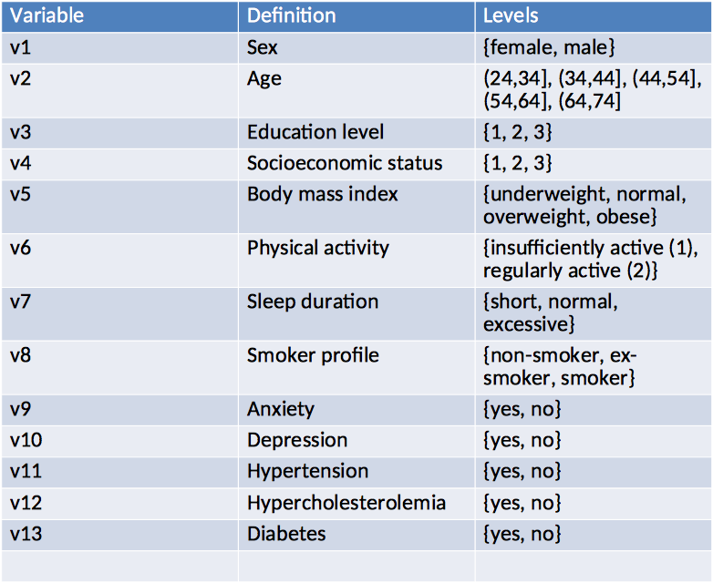
Building the Bayesian Network
Variables in model

Slide 4
Building the Bayesian Network
Data
Source: Annual health assessments (2012–2016), 205,087 cleaned records.
Variables: Non-modifiable (e.g., age, sex), Modifiable (e.g., BMI, smoking, activity), Medical conditions (e.g., hypertension, diabetes).
Methodology
Structure Learning: Greedy Thick Thinning (GTT) algorithm for dependencies.
Expert Refinement: Added 15 edges, reversed 7 connections.
Probability Estimation: Multinomial-Dirichlet with uniform priors.
Validation: 5-fold cross-validation achieving predictive accuracies of 91–93%.

Slide 5
The Greedy Thick Thinning algorithm
Aims to create the structure of the Bayesian network based on Data.
Computationally Efficient as iteratively adds and removes edges, focusing on improving the network incrementally rather than exploring all possible structures.
Suitable for Large-Scale Problems as it choses the minimum block set to conduct its independence tests.
Performs well even when the data is sparce.

Slide 6
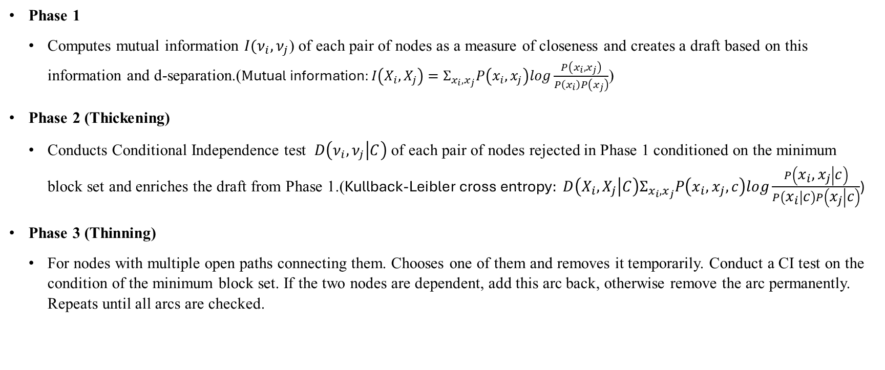
The Greedy Thick Thinning algorithm
Phase 1
Computes mutual information $I(ν_{i},ν_{j}$) of each pair of nodes as a measure of closeness and creates a draft based on this information and d-separation.($\text{M}\text{utual} \text{information}:I\left(X_{i},X_{j}\right)=Σ_{x_{i},x_{j}}P\left(x_{i},x_{j}\right)log\frac{P\left(x_{i},x_{j}\right)}{P\left(x_{i}\right)P\left(x_{j}\right)}$)
Phase 2 (Thickening)
Conducts Conditional Independence test $D\left(ν_{i},ν_{j} | C\right)$ of each pair of nodes rejected in Phase 1 conditioned on the minimum block set and enriches the draft from Phase 1.($\text{Kullback}\text{−}\text{Leibler} \text{cross} \text{entropy}: D\left(X_{i},X_{j} | C\right)Σ_{x_{i},x_{j}}P\left(x_{i},x_{j},c\right)log\frac{P\left(x_{i},x_{j} | c\right)}{P\left(x_{i} | c\right)P\left(x_{j} | c\right)}$)
Phase 3 (Thinning)
For nodes with multiple open paths connecting them. Chooses one of them and removes it temporarily. Conduct a CI test on the condition of the minimum block set. If the two nodes are dependent, add this arc back, otherwise remove the arc permanently. Repeats until all arcs are checked.

Slide 7

The Dirichlet Multinomial Bayesian Model
The Multinomial Distribution
The Multinomial Distribution is a Generalization of the Binomial Distribution.
$$P\left(x_{1},…x_{n};n,p_{1},…,p_{n}\right)=\frac{n!}{x_{1}! … x_{n}!}p_{1}^{x_{1}}…p_{n}^{x_{n}}$$
N = total count of observations.
$x_{1}…x_{n}$ = counts for category $i$.
$p_{1}…p_{n}$ = probability for category $i$.
The Dirichlet Distribution
It is a multivariate generalization of the beta distribution.
$P\left(x_{1},…,x_{n};a_{1},…,a_{n}\right)=\frac{Γ\left(Σ_{i}α_{i}\right)}{Π_{i}Γ\left(α_{i}\right)}Π_{i}x_{i}^{a_{i}−1}$
Where
$Σ_{i}x_{i}=1$ and $0≤x_{i}^{ }≤1 ∀i$. $B\left(a\right)=\frac{Π_{i}Γ\left(α_{i}\right)}{Γ\left(Σ_{i}α_{i}\right)}$.

Slide 8

The Dirichlet Multinomial Bayesian Model
The Posterior
Suppose that
$θ_{1},…,θ_{k}\sim Dir(a_{1},…,a_{k})$ (prior)
$y_{1},…,y_{k}\sim Mult(θ_{1},…,θ_{k})$(likelihood)
$P\left(θ | n\right)=\frac{P\left(n | θ\right)P(θ)}{P(n)}$ ∝ $\frac{N!}{\prod_{i}{n_{i}!}}\prod_{i}{θ_{i}^{n_{i}}}∗\frac{1}{B\left(α\right)}∗\prod_{i}{θ_{i}^{a_{i}−1}}$ ∝ $\prod_{i}{θ_{i}^{n_{i}}}∗\prod_{i}{θ_{i}^{a_{i}−1}}$=
= $\prod_{i}{θ_{i}^{{n_{i}+a}_{i}−1}}$ $\sim Dir(a+n)$.

Slide 9
Key Findings and Use Cases
Individual Predictions
Personalized risk assessment for medical conditions.
Example: Assessing hypertension risk in sedentary, overweight individuals.
Population Insights
Socioeconomic status influences risk (e.g., hypertension, diabetes).
Supports targeted public health strategies.
Intervention Analysis
Example: Regular physical activity reduces hypertension likelihood by ~25%.

Slide 10
Enhancements and Broader Applications
Dynamic Modeling: Track changes in risk factors over time.
Expanded Scope: Include diverse populations for generalizability.
New Variables: Add diet, alcohol use, and genetics for richer predictions.
Real-Time Data: Integrate wearable devices and electronic health records.
Cost-Effectiveness Analysis: Evaluate financial implications of interventions.

Slide 11
Citations
1. Bayesian Networks in Medical Diagnostics Their work has been cited extensively for demonstrating BNs' versatility in predictive modeling across different medical conditions.
2. Expansion to Broader Methodological Frameworks The NEAR framework cites Ordovás et al. as a benchmark for explainable predictive systems.
3. Risk Analysis in Diverse Domains Studies on insurance models and chronic disease disparities reference Ordovás et al.'s integration of datasets with expert knowledge.
4. Foundational Role in Cardiovascular Research Several studies directly draw upon Ordovás et al.'s methodology to explore heart disease classification.

Slide 12
Thank you!

Slide 13
References
1. Wang, Y., et al. (2020). Survivability Modeling Using Bayesian Networks for Patients with First and Second Primary Cancers. Journal of Biomedical Informatics. [Extracted from prior work upload]
2. Kyrimi, E., et al. (2021). A Comprehensive Scoping Review of Bayesian Networks in Healthcare. Journal of Applied Artificial Intelligence.
3. Farooq, K., et al. (2011). Ontology-Driven Cardiovascular Decision Support System. Computational Intelligence in Cardiovascular Healthcare.
4. Tylman, W., et al. (2016). Real-Time Prediction of Acute Cardiovascular Events Using Bayesian Networks. Journal of Emergency Cardiology.
5. Thornley, S., et al. (2013). Using Directed Acyclic Graphs for Investigating Causal Paths for Cardiovascular Disease. BMC Medical Research Methodology.
6. Roberts, J., et al. (2006). Bayesian Networks for Cardiovascular Monitoring: Integrating Diverse Data Sources. International Journal of Cardiology Informatics.
7. Santos-Lozano, A., et al. (2021). Association Between Physical Activity and Cardiovascular Risk Factors. Cardiovascular Medicine and Exercise Science.
8. Fiuza-Luces, C., et al. (2018). Exercise Benefits in Cardiovascular Disease: Beyond Attenuation of Traditional Risk Factors. Nature Reviews Cardiology, 15(12), 731–743.

Slide 14
9. World Health Organization (2021). Cardiovascular diseases (CVDs). WHO Fact Sheets.
10. Huh, J., (2023). Bayesian Network Updating Using Novel Clinical Data: A Practical Approach. Healthcare Informatics Research.
11. Esmaeili, P., et al. (2024). Unraveling atherosclerotic cardiovascular disease risk factors through conditional probability analysis with Bayesian networks: insights from the AZAR cohort study. Journal of Clinical Cardiology.
12. Salman, I., et al. (2023). Development and Performance Evaluation of a Novel Bayesian Network Model for the Classification of Heart Disease. Cardiovascular Computing.
13. Wang, B., et al. (2024). A Novel Bayesian Pay-As-You-Drive Insurance Model with Risk Prediction and Causal Mapping. Risk Analysis Journal.
14. Babagoli, M., et al. (2024). Bayesian Network Model of Ethno-Racial Disparities in Cardiometabolic-Based Chronic Disease Using NHANES 1999–2018. American Journal of Preventive Medicine.
15. Chu, O., H., et al. (2024). Development and Application of an Optimized Bayesian Shrinkage Prior for Spectroscopic Biomedical Diagnostics. Journal of Biomedical Statistics.
16. Sun, B., et al. (2023). A Breast Cancer Detection Method Based on Bayesian Networks. Journal of Oncology Informatics.
17. Corrales, D., et al. (2024). Colorectal Cancer Risk Mapping Through Bayesian Networks. Cancer Epidemiology Research.

Slide 15
18. Kassem, K., et al. (2024). An Innovative Artificial Intelligence-Based Method to Compress Complex Models into Explainable, Model-Agnostic and Reduced Decision Support Systems with Application to Healthcare (NEAR). Artificial Intelligence in Medicine.
19. Cheng, J., Bell, D. A., & Liu, W. (1997). An algorithm for Bayesian belief network construction from data. Proceedings of the Conference on Artificial Intelligence and Statistics, 83–90

